Slide 1
8 Months vs. 8 Weeks:
Rapid-Project LMS Implementation
Thomas J. Tobin
Northeastern Illinois University

Slide 2

The Need
Campus leaders typically make no larger expenditure than on the Learning Management System (LMS) that hosts their e-course content.
To increase the efficiency and transparency of the process of implementing the LMS, NEIU followed a phased approach, using the structures and processes of formal project management.
You will learn the key processes of project management, and take away practical how-to tips on implementing a new LMS quickly or adding elements to an existing one.
But first…

Slide 3
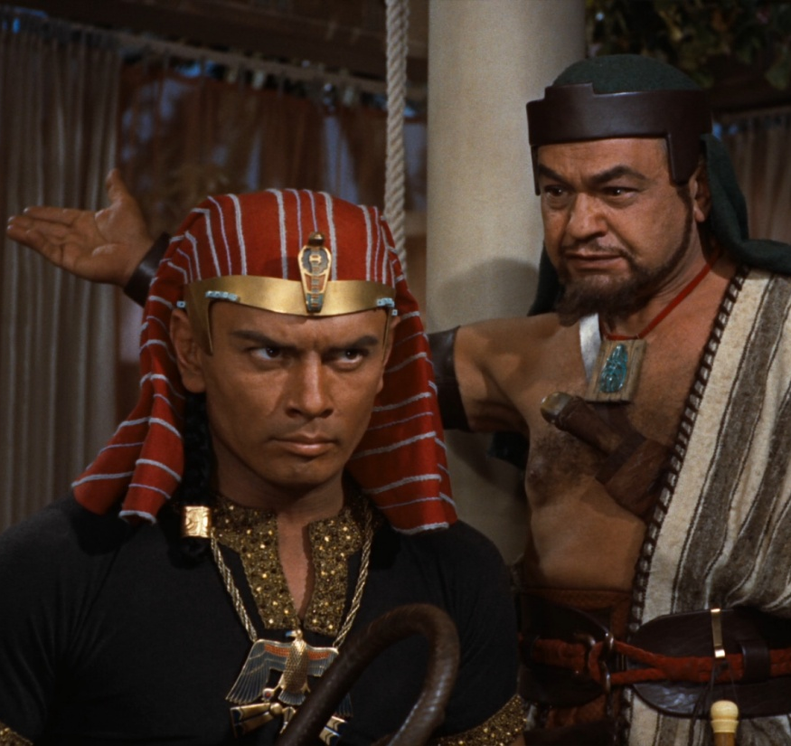
Thought Exercise: Pharaoh’s Bling
Pharaoh has chosen you to build a fitting monument to his glory.
What do you need in order to start up and then keep the project going?
P.S.: Don’t make Yul Brynner mad!
you
Pharaoh

Slide 4

What is Project Management?
“Project management is the discipline of planning, organizing, securing, and managing resources to achieve specific goals. A project is a temporary endeavor with a defined beginning and end (usually time-constrained, and often constrained by funding or deliverables), undertaken to meet unique goals and objectives, typically to bring about beneficial change or added value. The temporary nature of projects stands in contrast with business as usual (or operations), which are repetitive, permanent, or semi-permanent functional activities to produce products or services.”
Project Management Institute. A Guide to the Project Management Body of Knowledge (PMBOK Guide). 4th Ed. Newtown, PA: PMI, 2008.

Slide 5
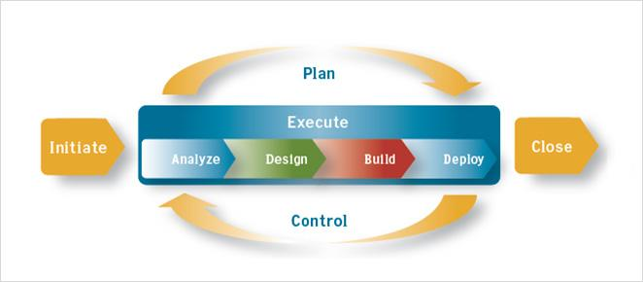
Phases of Project Management
http://proteleco.com/images/diagram-projectmanagement.jpg

Slide 6
 | Integration | Scope | Time | Cost | Quality | Human Resources | Communications | Risk | Procurement
Initiating | Develop Project Charter |  |  |  |  |  | Identify Stakeholders
Planning | Develop Project Management Plan | Collect Requirements Define Scope Create WBS | Define Activities Sequence Activities Estimate Activity Resources Estimate Activity Durations Develop Schedule | Estimate Costs Determine Budget | Plan Quality | Develop Human Resource Plan | Plan Communications | Plan Risk Management Identify Risks Perform Qual/Quant Risk Analysis Plan Risk Responses | Plan Procurements
Executing | Direct and Manage Project Execution |  |  |  | Perform Quality Assurance | Acquire Project Team Develop Project Team Manage Project Team | Distribute Information Manage Stakeholder Expectations |  | Conduct Procurements
Monitoring & Controlling | Monitor & Control Project Work Perform Integrated Change Control | Verify Scope Control Scope | Control Schedule | Control Costs | Perform Quality Control |  | Report Performance | Monitor & Control Risks | Administer Procurements
Closing | Close Project or Phase |  |  |  |  |  |  |  | Close Procurements
Project Management Processes

Slide 7

included all required elements
met the university’s needs
was sufficiently inclusive in scope
contained needed activities
communicated with all stakeholders
planned for costs
identified and mitigated against risks
reported its progress and completion to all involved
How Do We Go Faster?
By following the formal structure of Initiating, Planning, Executing, Monitoring, and Closing the LMS implementation project, NEIU was able to ensure that the project . . .

Slide 8
Let’s Check In With Pharaoh
How is that monument coming along?
What items from your list seem to fall in to the five project processes?
Initiating
Planning
Executing
Monitoring & Controlling
Closing
you
Pharaoh

Slide 9

Before You Start: Hints for Project Managers
Balance representatives of stakeholder groups.
Know your project scope.
Build in slack for the unexpected.
Decide how “strict” and “deep” your structure will be.
Identify the skeptics and recruit them.
PM is really relationship management!

Slide 10


Initiating
Develop Project Charter
Identify Stakeholders

Slide 11
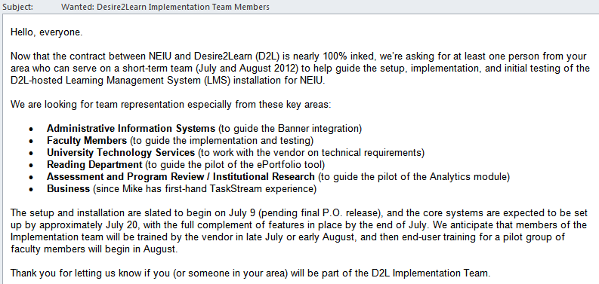
Initiating: The Local Team

Slide 12
Ask for templates and planning files before the project starts.
Provide core setup information to the vendor ahead of time.
Ensure that communication funnels through only one point each for the client and the vendor.
Develop a charter agreement.
Identify all stakeholders, and create a “super board” of the most involved.
Initiating: The Rapid Project

Slide 13
Develop Project Management Plan
Collect Requirements
Define Scope
Create WBS
Define Activities
Sequence Activities
Estimate Activity Resources
Estimate Activity Durations
Develop Schedule
Develop Human Resource Plan
Plan Communications
Plan Risk Management
Identify Risks
Perform Qual/Quant Risk Analysis
Plan Risk Responses
Estimate Costs
Determine Budget
Plan Quality
Plan Procurements
Planning

Slide 14
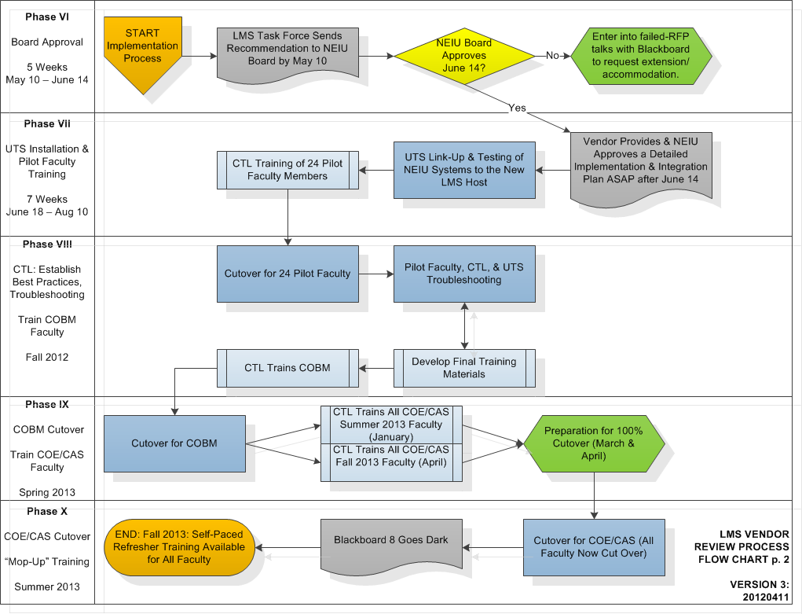
Planning

Slide 15
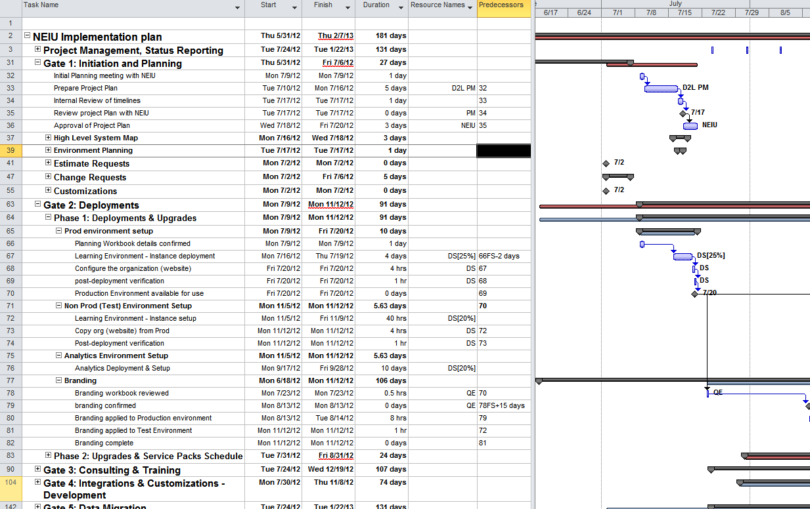
Planning: PM to PM

Slide 16
Plan tasks to be accomplished in parallel, rather than serially.
Assign resources to tasks, and plan for backups/handoffs.
Develop a “flow to the work” strategy.
Create a gated plan for major milestones and phases.
Find many people to support multiple tasks, each for a short interval (rather than one person to do all tasks).
Designate one person as a task-schedule checker (usually the PM).
Planning: The Rapid Project

Slide 17
Direct and Manage Project Execution
Perform Quality Assurance
Acquire Project Team
Develop Project Team
Manage Project Team
Distribute Information
Manage Stakeholder Expectations
Conduct Procurements
Executing

Slide 18
LMS RFP Task Force
Meeting Agenda
March 14, 2012
Action Items from Last Week
BB is reviewing the general vendor-viability requirements.
BB will check with Purchasing about how to respond to vendors who don’t want to share financial information.
BR to categorize the reference-interview questions.
EH will divide up the reference-call tasks for all Task Force members.
Viability: Reference Call Setup Report
Tech Review: Status Update from UTS
Cost: Financial Disclosure Review Process
Functional Review: Status Update
TT: Need to Extend FRT Evaluations by 1 Week
MR: Vendor 4 Setup Concerns
Calendar: Looking Ahead to April and May
TT: Revised Flow Chart and Calendar
Communication: Status Check from Admin Team Meeting & Campus Newspaper
EH & BB
Training: 3 Models, Need Feedback
Entire Task Force
Executing

Slide 19
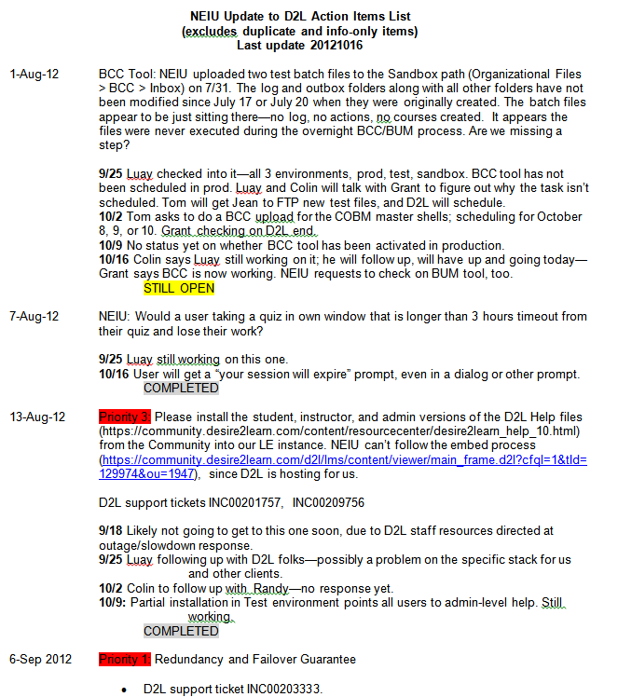
Executing:
PM to PM

Slide 20

Perform random quality checks on specific tasks.
Keep a prioritized action-items list.
Distribute information regularly via the project managers.
Create 1-on-1 time for stakeholders experiencing challenges.
Ensure that task resources know whom to notify about completion, and to who to hand off.
Increase communication frequency between PMs.
Executing: The Rapid Project

Slide 21
Monitor & Control Project Work
Perform Integrated Change Control
Control Scope
Control Schedule
Control Costs
Perform Quality Control
Report Performance
Monitor & Control Risks
Administer Procurements
Monitoring & Controlling

Slide 22
3,000 Years is a Long Time
Every project manager forgets or fails to anticipate something (e.g., what about Pharaoh’s mummified cats?).
Build in “slack,” pause points, and pre-mortem discussions.
you
Pharaoh

Slide 23
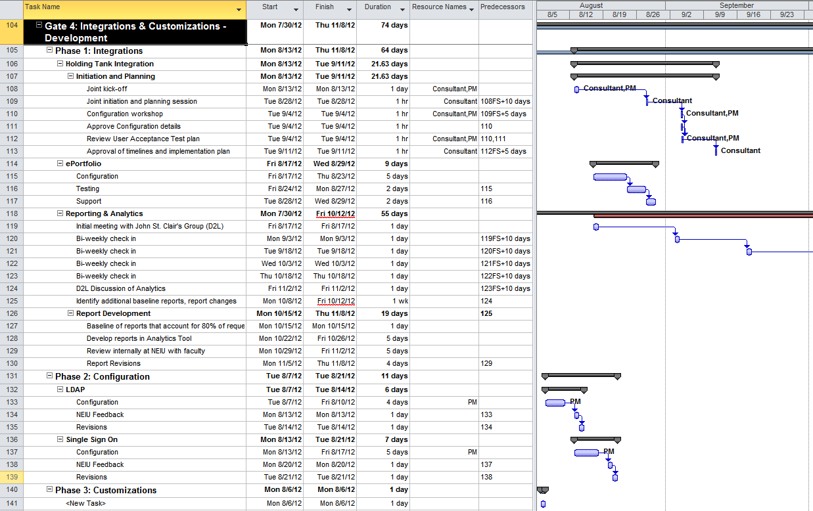
Monitor/Control: PM to PM

Slide 24

Adopt changes via rapid-response approval/denial chains.
Ensure that the project stays within scope and on schedule.
Perform a “pre-mortem” examination.
Report on overall performance status to all stakeholders.
Assess existing and new risks regularly.
Continue quality-control “spot checks” of random tasks.
Monitor/Control: The Rapid Project

Slide 25

Closing
Close Project or Phase
Close Procurements
Eval

Slide 26
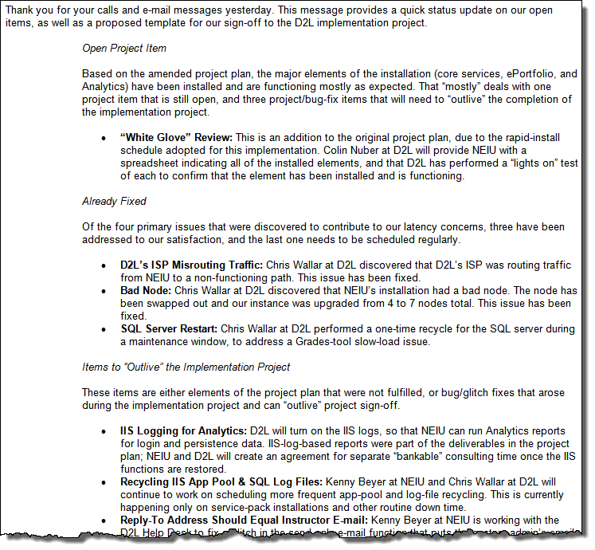
Closing:
PM to PM

Slide 27

Ask for a “white glove” review of all work done by the vendor, based on reported accomplishments.
Set aside a specific time period for last-minute change control.
Adopt “rolling closure” approvals—approve closure of individual gated phases that eventually roll up to full approval.
Get sign-off authority from the final approver, or have the final approver on call toward the end of the project.
Closing: The Rapid Project

Slide 28

Take-Aways
Have a Plan
Build Flexibility
Involve Stake-holders
Communi-cate...
(a lot)
Follow the Process
http://www.pmi.org/

Slide 29
Thank You!
t-tobin@neiu.edu

